Slide 1
Basketball

Slide 2
Keep Your Heads On!
A basketball-type game was played 500 years ago by the Olmec people in ancient Mexico! Instead of using a ball they used the skulls of people who they had conquered.
http://nbahoopsonline.com/Articles/History1.html

Slide 3
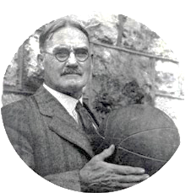
The Invention of Today’s Basketball
A physical education teacher named James Naismith came up with basketball and its 13 original rules that we still use today!
He came up with this game for his class at the YMCA training school in Springfield, Massachusetts. This school is now known as Springfield College.
He made goals out of peach buckets!
This game gained a lot of popularity, and the copy of the rules were published on January 15, 1892.
https://www.britannica.com/sports/basketball

Slide 4
Bounce the Ball?
James Naismith did not allow the players to bounce the ball down the playing field. In order to advance down the playing field, they had to pass the ball down the field to their teammates and shoot the ball into the peach basket!
https://www.britannica.com/sports/basketball

Slide 5
Put Me in Coach
James Naismith would play certain numbers of players based on the size of the playing field. Once they started making standardized court sizes, they started playing with 5 vs 5.
https://www.britannica.com/sports/basketball

Slide 6
Rules
Today we still use 9 out of 13 of the original rules! Some of the rules were changed to keep it fast-paced and entertaining. It is pretty amazing that the game he invented is still being played and enjoyed by millions of people 125 years later!
https://www.nfhs.org/articles/the-original-rules-of-basketball-how-little-they-have-changed/

Slide 7
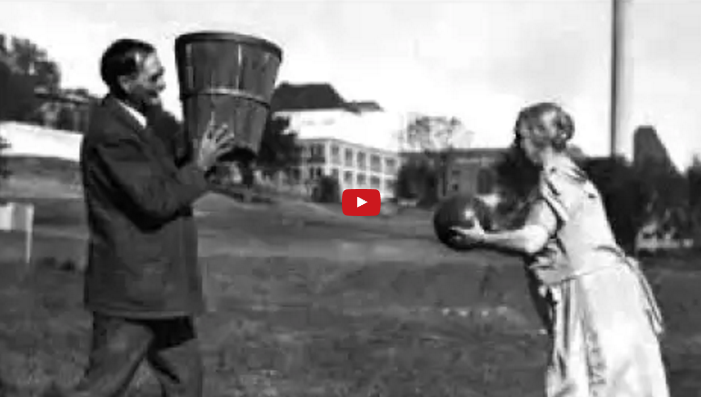
Interview with James Naismith in 1939!

