Slide 1
Football

Slide 2
Rugby Football
Football has been around for a long time. It was played in England in 1863. However, it was not the type of football that we know today. It was called Rugby Football.
https://www.fifa.com/about-fifa/who-we-are/the-game/

Slide 3
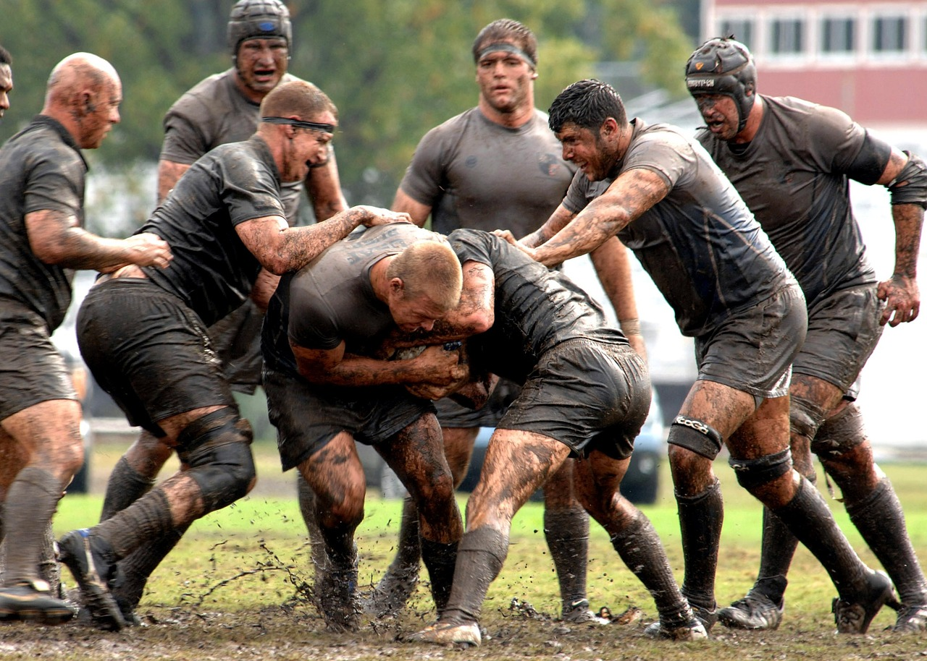
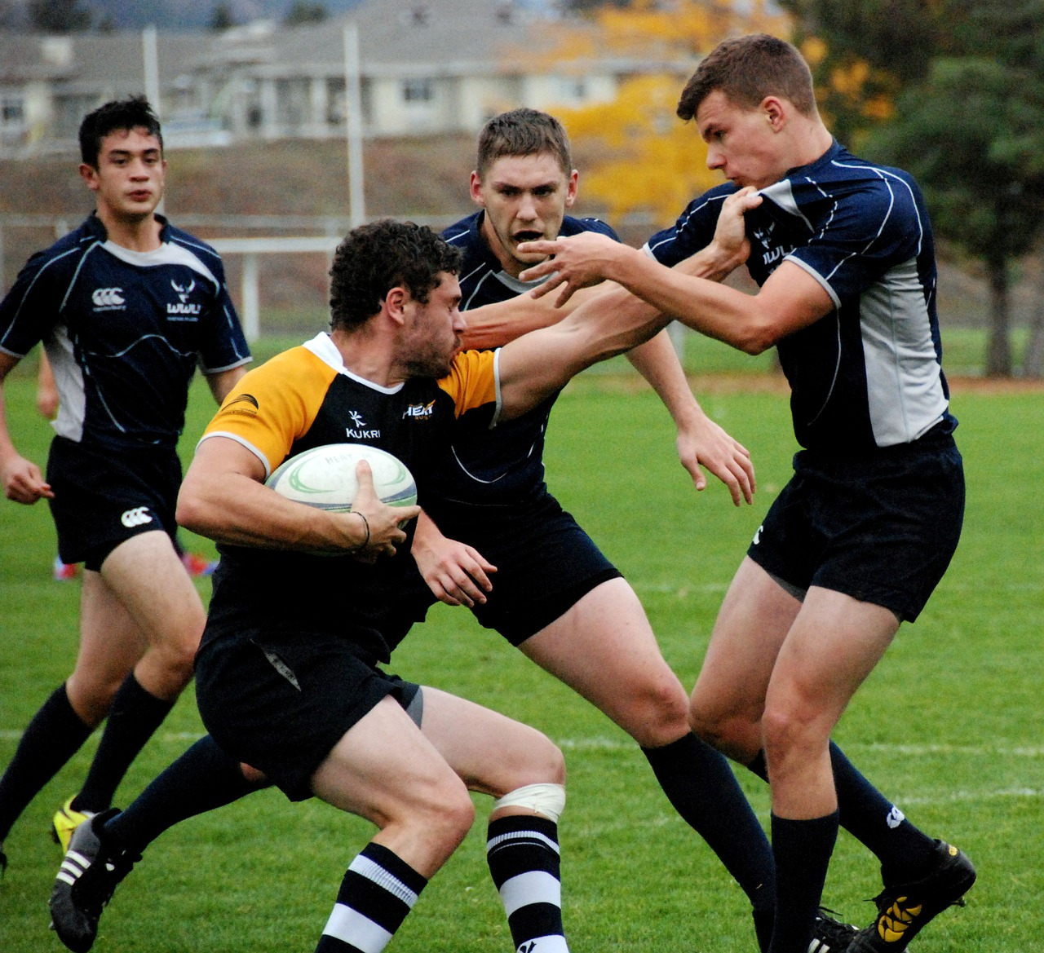
Rugby Football

Slide 4
The father of American Football
Walter Camp introduced new rules in the 1880’s. It became a lot less like Rugby and more like the football we know today! Here are the things that Walter Camp came up with:
Scrimmage line
11-man team
Signal-Calling
Quarter back Position
The offensive team had to give up the ball if they did not make it a certain distance
Set number of downs
http://www.footballfoundation.org/Programs/CollegeFootballHallofFame/SearchDetail.aspx?id=88004

Slide 5
Walter Camp

Slide 6
Helmet
In the 1900’s, football head protection was called a head harness. They were made of leather. Oddly, these were made not to protect the head but to protect the ears. However, it was hard to hear things when they had these head harnesses on in the game.
In 1915-1917, they realized they should probably protect their heads and designed a head guard. They made ear holes in these helmets so they could hear better!
In 1939, they designed the first plastic helmet. Later, they had one bar to protect the face. This is when the NFL made wearing the helmet mandatory while playing.
They have been working on improving the helmets ever since!
http://www.livestrong.com/article/350519-the-history-of-football-equipment/

Slide 7
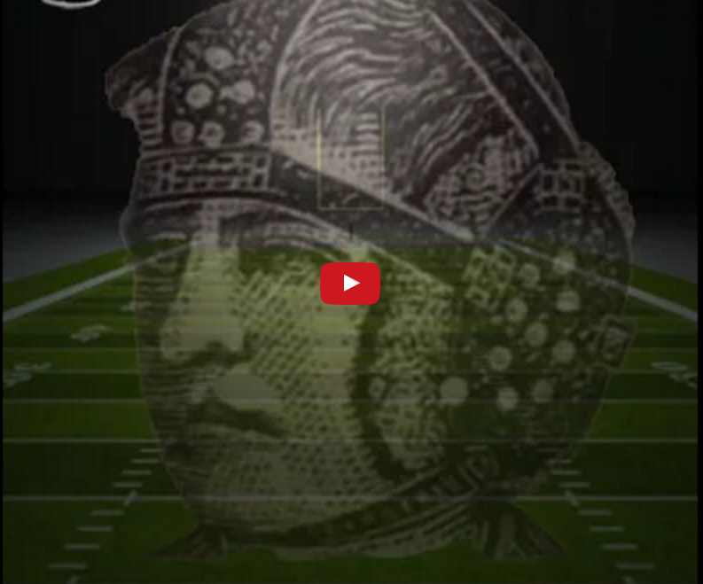
Football Helmets through the Years

Slide 8
Shoulder Pads
When football first started, it was uncool to wear shoulder pads under your uniform. Players would make fun of the ones who padded themselves.
Shoulder pads did not become very popular until the 1950s. They wore leather pads.
In 1960, they invented the plastic shoulder pads.
In 2002, shoulder pads were made with synthetic fibers so that they were more comfortable and could breathe easier.
In Florida, they made shoulder pads with a temperature management system. The players go to the sidelines and have air pumped into their pads to help cool them off!
http://www.livestrong.com/article/350519-the-history-of-football-equipment/

Slide 9
The Ball
The first ball was a pigs bladder. They were round and pretty durable. As time went on, they started covering the pig bladder with a leather covering. They stitched laces on the ball to keep the leather together. Today’s footballs still have those laces but they are not on there to keep the leather together. They were hard to air up, so their shape and size did change. This is where the football got its shape.
http://www.livescience.com/32808-nfl-football-spheroid-origins.html

