Slide 1
Golf

Slide 2
Old as Time
Golf-like games have been around since 100 B.C. The Romans used to play a game called Paganica. In this game, they would use a bent stick to hit a leather ball.
In China during 960 B.C.-1279B.C., they played a similar game called Chuiw’an. In this game, they used 10 different clubs, holes with flags, and wooden balls that are of different sizes. It was pretty close to the golf we play today.
The modern rules came from Scotland in the 15th Century.
https://www.igfgolf.org/about-golf/history/

Slide 3
Work Hard, Play Hard or Things Get Banned!
In 1457 B.C., the Scottish Parliament had to ban the game of golf because it was interfering with archery practice. This was not the only sport that was banned at this time. They also banned soccer. King James IV decided to get rid of the ban when he got involved in playing. The ban only lasted two years.
https://www.igfgolf.org/about-golf/history/

Slide 4
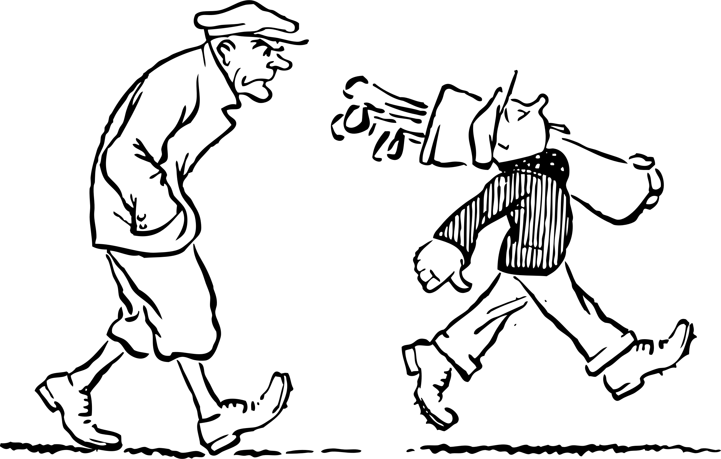
Caddies
The name caddie comes from Mary, Queen of Scots, in the 16th Century.
Only royalty had caddies.
The caddie carries the clubs for the golfer.
https://golfmatchapp.com/8-fun-facts-about-caddies

Slide 5
Caddies Make a Sweet Penny!
PGA tour caddies can make anywhere from $1,000-$1,500 per week!
They also make a percentage of what the golfer wins.
https://golfmatchapp.com/8-fun-facts-about-caddies

