Slide 1
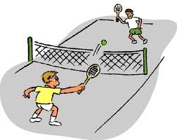
Pickleball

Slide 2
Beat the Boredom
In 1965 in Bainbridge Island, Washington, three dads, Joel Pritchard, Bill Bell, and Barney McCallum created this wonderful game we know as pickleball! Tennis, table tennis, and badminton inspired the rules of pickleball!
https://sundialresort.com/blog/10-facts-didnt-know-pickleball/

Slide 3
Beat the Boredom
The dads came home after a long day of golf and discovered their families sitting around bored. The kids were driving the adults nuts! The dads had to come up with something to entertain the kids.
https://sundialresort.com/blog/10-facts-didnt-know-pickleball/

Slide 4
What to Do?
Joel Pritchard found ping-pong paddles and a softball-sized plastic ball. He told the kids to go outside and play. So they went to Joel’s backyard to the badminton court and started volleying the ball back and forth.
http://www.usapa.org/history-of-the-game/

Slide 5
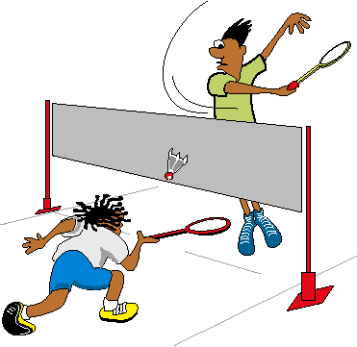
Experimental Play
When they first played, they played using badminton regulations – where the net is 60 inches from the ground – and volleyed it back and forth. The kids did this for hours!
http://www.usapa.org/history-of-the-game/

Slide 6
It Bounces
Throughout the weekend, they noticed that the ball bounces pretty well on concrete. They decided to put the net at 36 inches and allow the ball to bounce. The kids had a blast playing. At first, there were no rules. They were just having fun playing.
http://www.usapa.org/history-of-the-game/

Slide 7
The Creation of Pickleball
The three men created rules and equipment for the game. The ping-pong paddles would break because the plastic ball was too big for the small paddles.
http://www.usapa.org/history-of-the-game/

Slide 8
Why is it Called Pickleball?
A Cocker Spaniel who was owned by Joel Pritchard loved to chase the balls while the family played the newly created game. The dog’s name was Pickles. So that is how this game got such a funny name!
https://sundialresort.com/blog/10-facts-didnt-know-pickleball

Slide 9
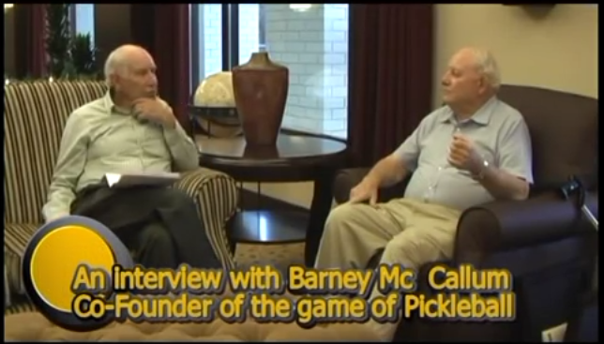
Watch The Interview

